Slide 1
matplotlib basics

Slide 2
matplotlib is the main plotting module to use with python
typical import in a python program is:
import matplotlib.pyplot as plt
however sometimes we import other parts of matplotlib, e.g. to create custom colormaps (see Thursday's lecture)
matplotlib excels at 2-D plots. In my experience MATLAB is better, and faster for fancy 3-D plots, like objects with lighting, but there may be python modules I don't know about

Slide 3
my examples
Examples are available on the parkermac GitHub repo "pmec" in the folder ex_matplotlib
plt_basics.py covers basic line plotting operations, and ways to make multiple plots on a figure
fields.py covers ways to plot 2-D fields using colors and contours

Slide 4
plt_basics.py

Slide 5
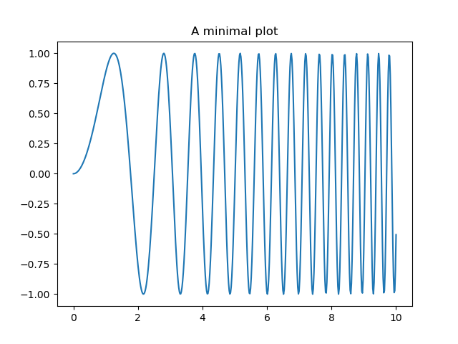

Slide 6
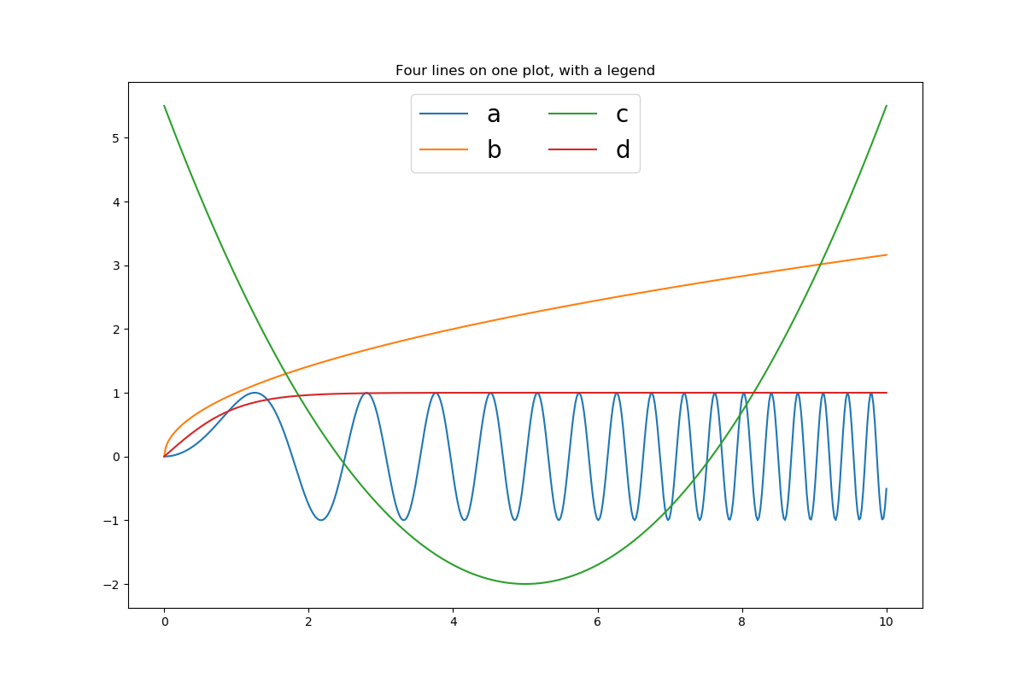

Slide 7
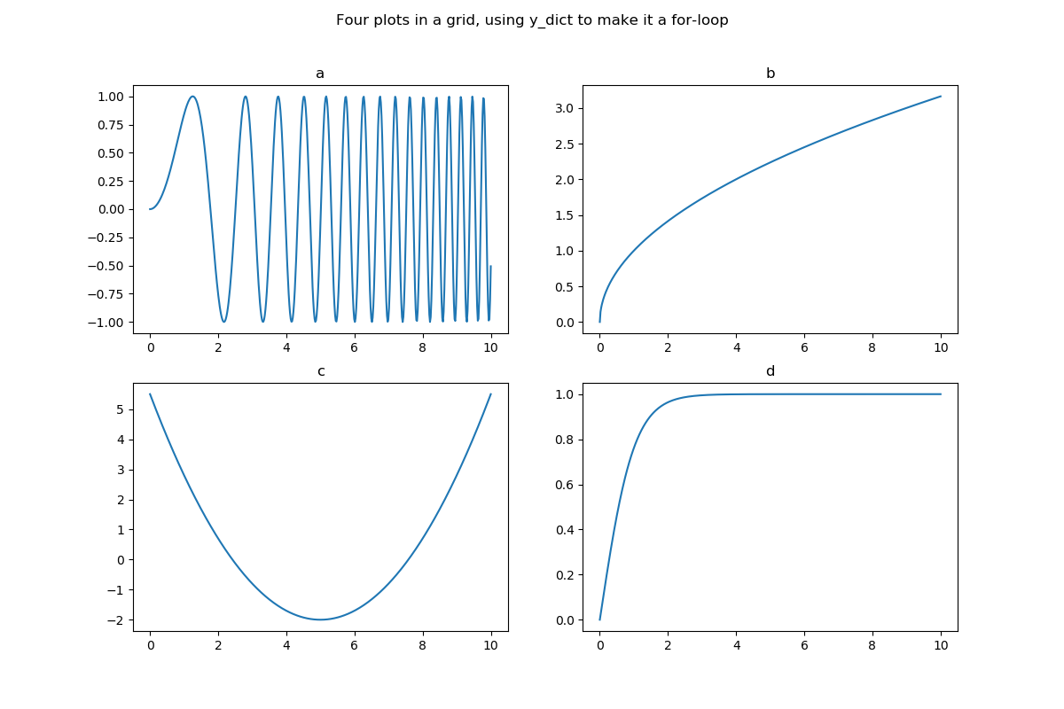

Slide 8
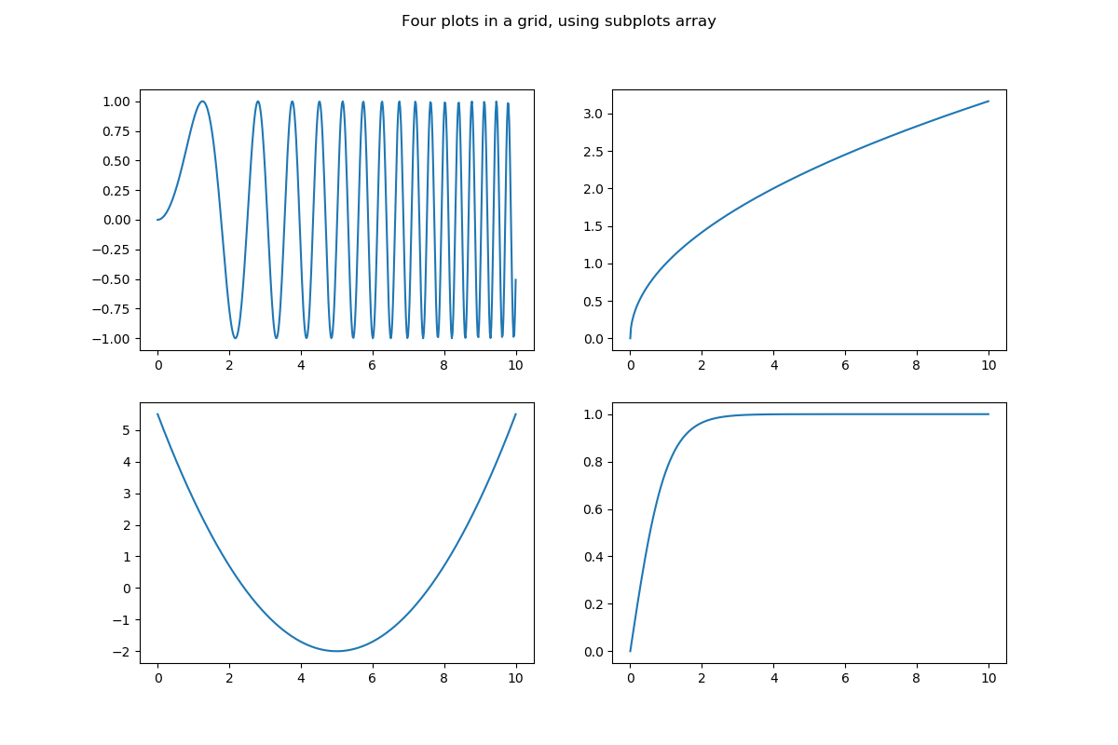

Slide 9
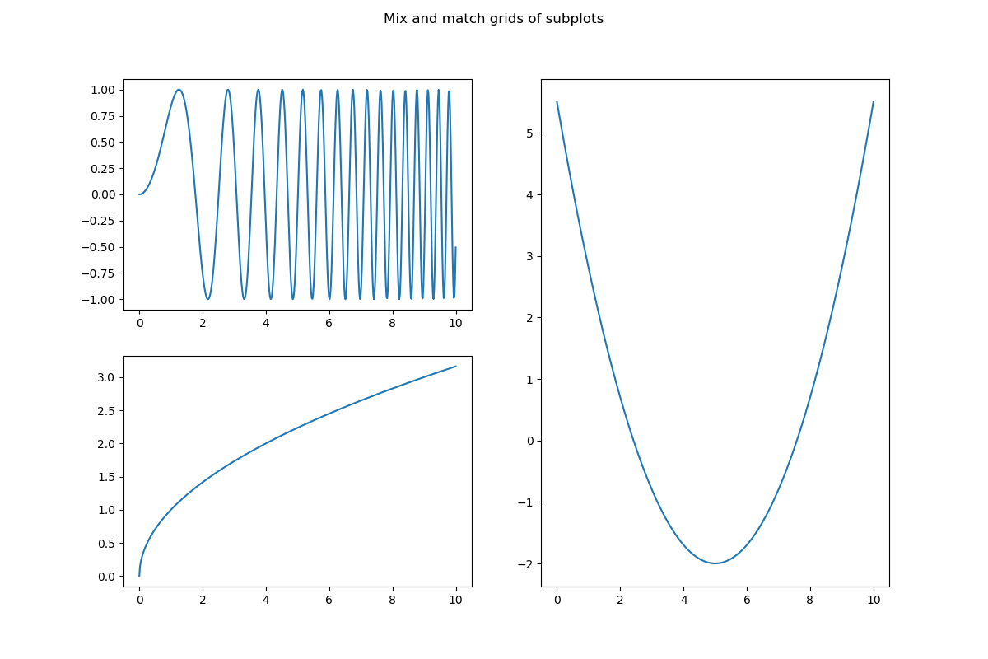

Slide 10
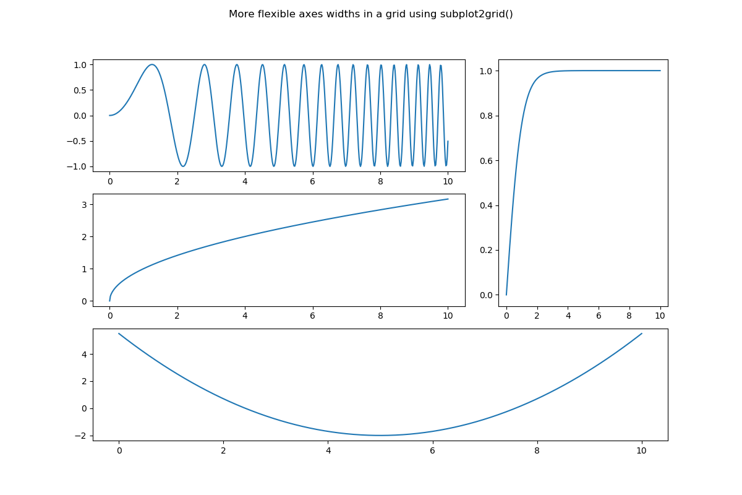

Slide 11
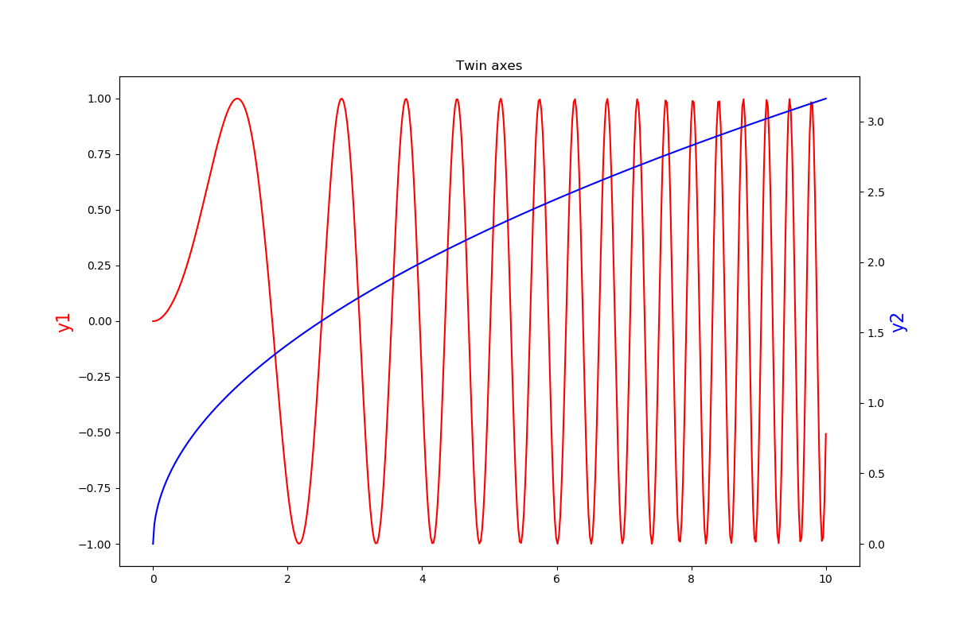

Slide 12
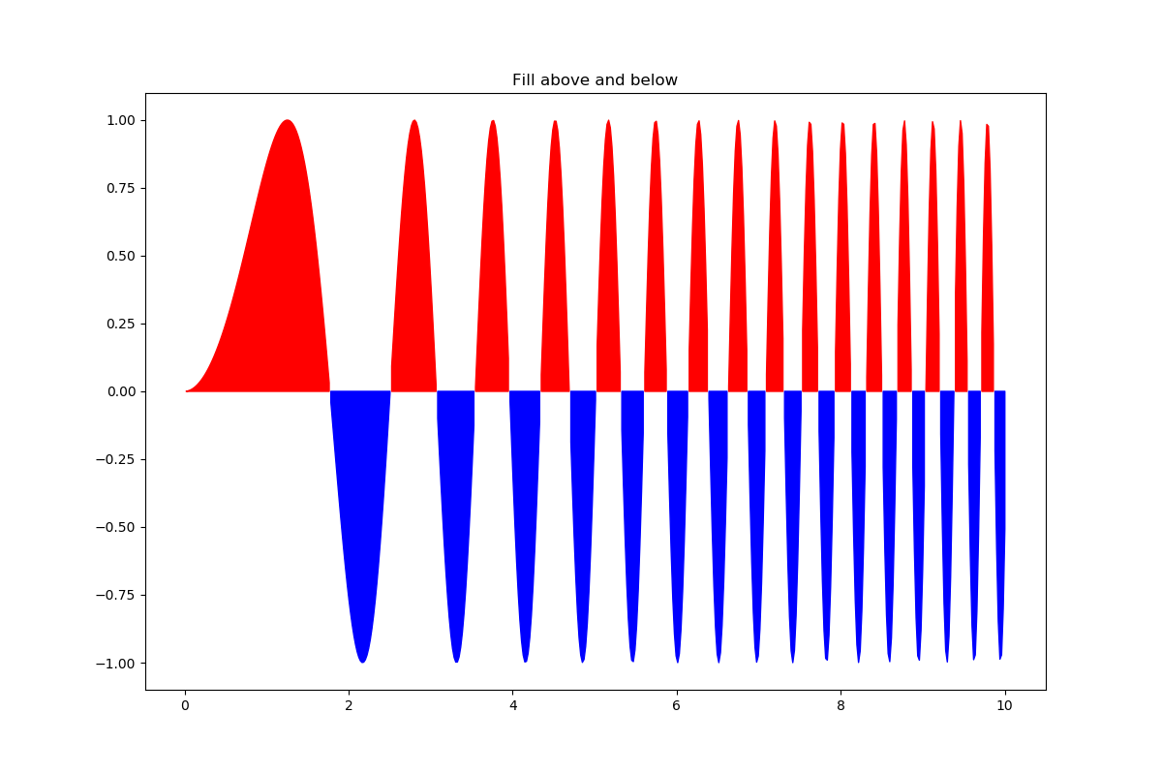

Slide 13
fields.py

Slide 14
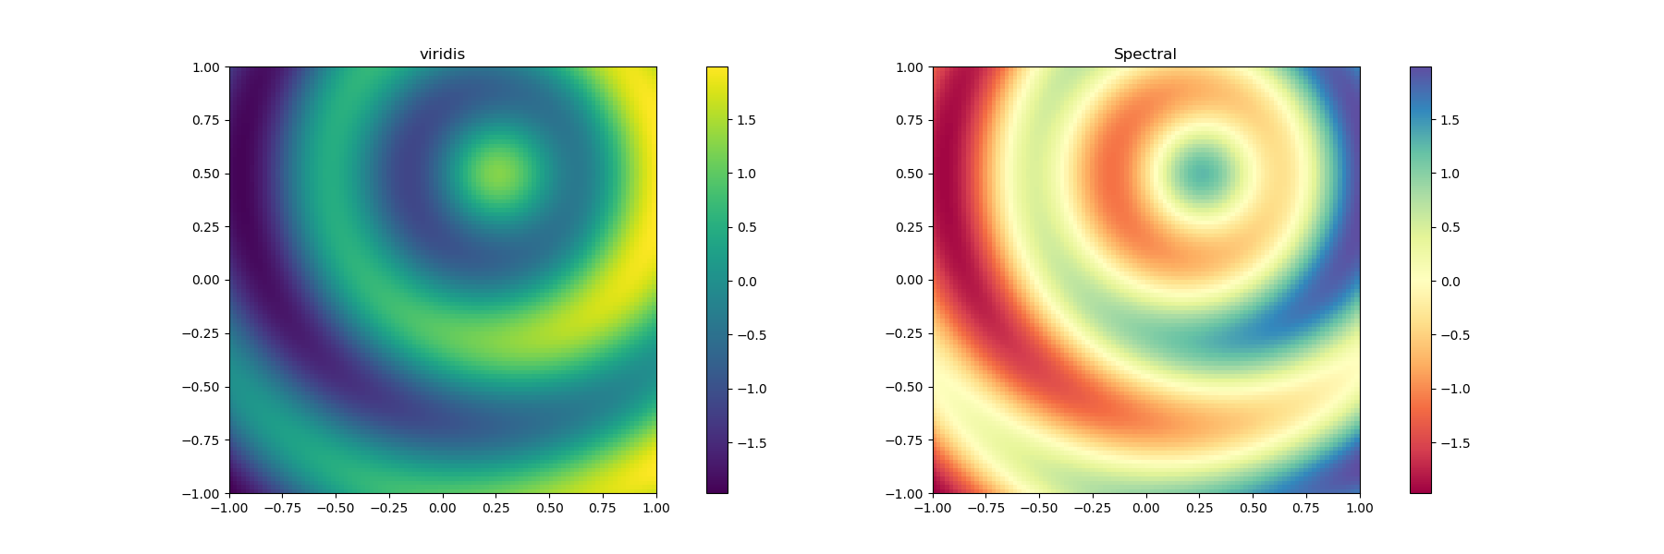

Slide 15
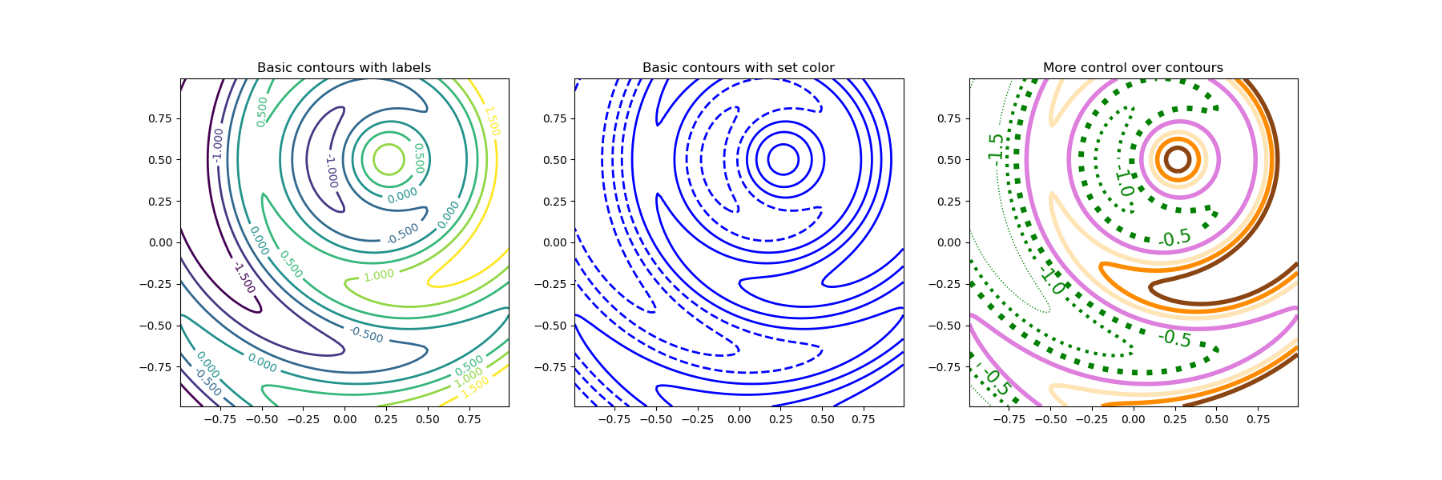

Slide 16
plotting on a remote machine (like fjord)
On your laptop you typically launch python as "ipython --pylab" which sets the graphical backend. Then you can see plots on your screen, as well as saving them as .png's. The typical laptop launch is:
ipython --pylab
import matplotlip.pyplot as plt
On a remote machine you are working from the terminal, and so you can't see plots, but you can still save .png's. On fjord the typical launch sequence is:
ipython
import matplotlib as mpl
mpl.use('Agg')
import matplotlib.pyplot as plt
I build these into my plotting programs with an if-statement that uses some knowledge of which machine I am working on. You could also make it a command line argument using argparse.
See the example "remote_printing.py" in pmec/ex_matplotlib

Slide 17
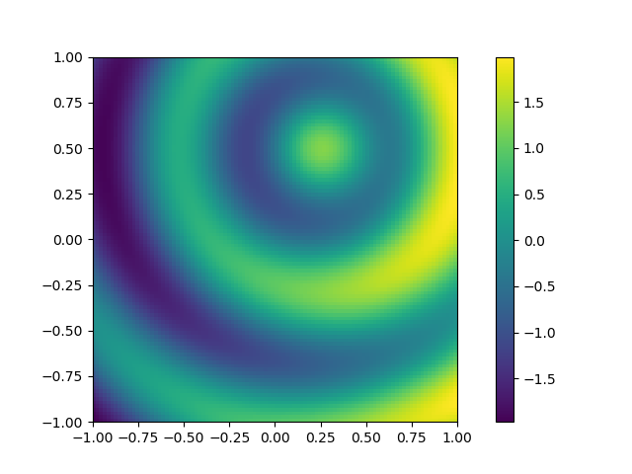
remote_printing.png on fjord from remote_printing.py

Slide 18
Finding information
The primary module is matplotlib.pyplot (plt), and typical objects you create are figures (fig), axes (ax), colormaps or contours (cs), and text (h)
Each of these has its own methods, and each method accepts some required arguments (like x and y for a line plot) and some optional "keyword arguments" or "kwargs" (like linewidth=4).
It can sometimes (often!) be confusing which object and which method to use to achieve a desired result.
Sometimes there is an obvious hierarchy:
plt has a method for making figures
figures have a method for adding subplots (axes)
axes have methods for actual plotting
and when you do a plotting operation (e.g. add contours) it will return an object that you can inspect to find applicable methods

Slide 19
Finding information, continued...
To find out what methods can be used with an object, and what required and keyword arguments are possible with a method there are several techniques.
Say you have an axis object "ax":
dir(ax) will give a list of all valid methods, e.g. plot
help(ax.plot) gives, sometimes, a useful tutorial, although it can take some patience to read them
ax.plot? will give more succinct information (often my favorite) such as this for the "linestyle" kwarg:
linestyle or ls: {'-', '--', '-.', ':', '', (offset, on-off-seq), ...}
which is saying that you could plot a dashed line using ax.plot(x,y, ls='--')
ax.plot?? give a nicely colorized, but over-long version of everything you can do
Sometimes you need to dig deeper, e.g. if you want to add some fancy text:
help(ax.text) will give basic information, but will suggest you look at **kwargs : `~matplotlib.text.Text` properties to find kwargs info
to follow this suggestion use help(matplotlib.text.Text) or matplotlib.text.Text? which will also show all valid kwargs, but to do this you first have to import matplotlib (not just matplotlib.pyplot)
NOTE: Text is the class for creating text object instances.

Slide 20
Resources
https://matplotlib.org/ the home page
https://matplotlib.org/users/index.html a Users Guide
https://matplotlib.org/gallery/index.html an incredibly useful galley of examples, including plots and the code that made them

